Slide 1



FACULTY OF COMPUTING
Notes:
MmaNaa @ 2011/12(1)

Slide 2
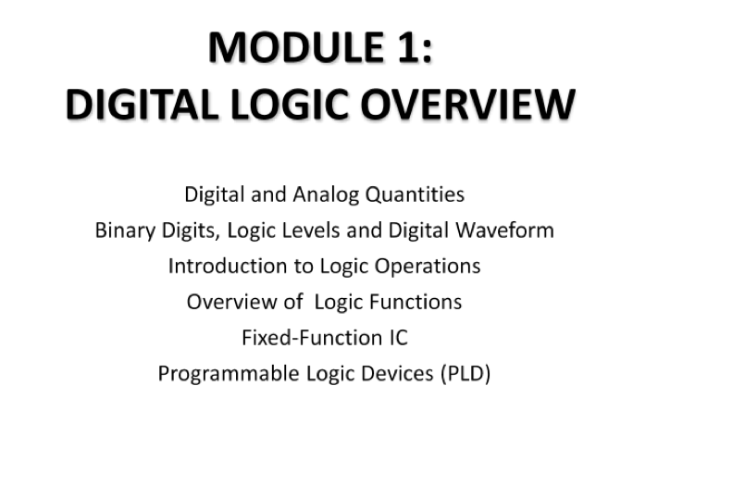
CONTENTS
Notes:
MmaNaa @ 2011/12(1)

Slide 3
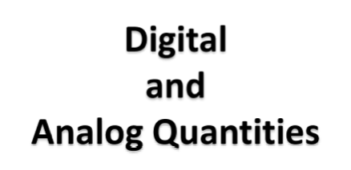

Slide 4
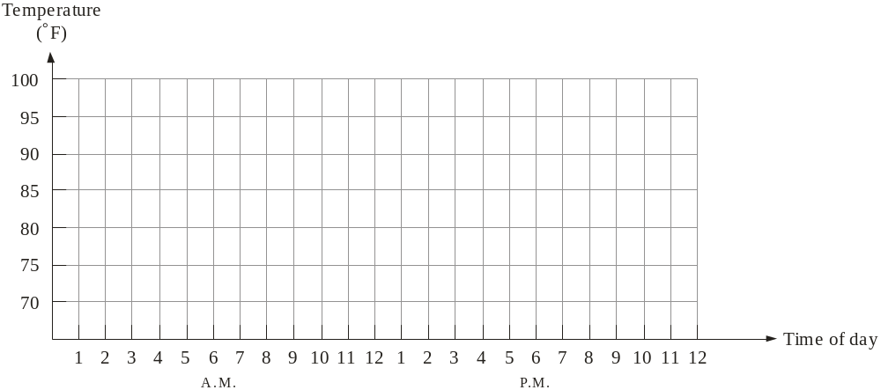
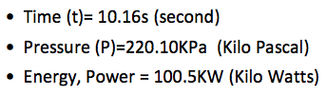

Analog quantities
Most natural quantities that we see are analog and vary continuously.
Analog systems can generally handle higher power than digital systems.
Example:
Resource: Floyd, Digital Fundamentals, 10th Edition

Slide 5
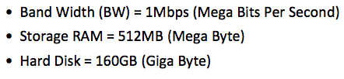
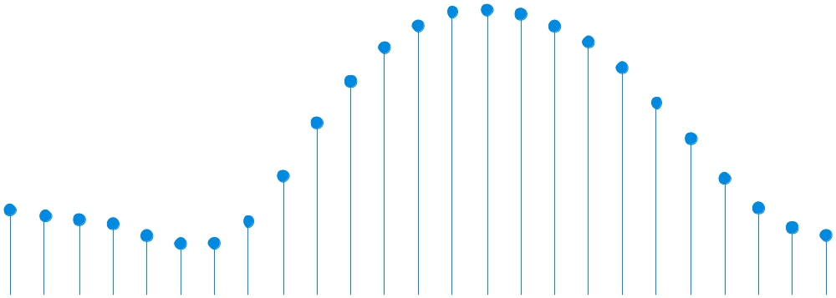
Digital quantities
Example:
Digital systems can process, store, and transmit data more efficiently but can only assign discrete values (discontinuous) to each point.
Resource: Floyd, Digital Fundamentals, 10th Edition

Slide 6
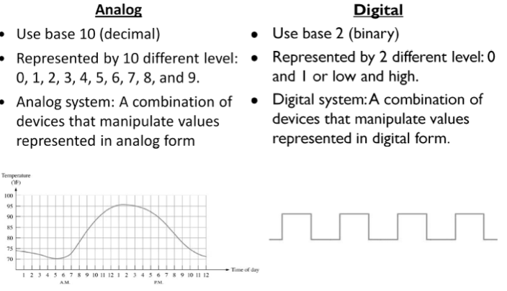
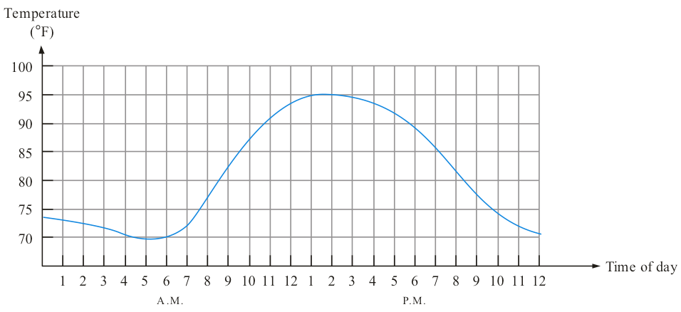
Analog vs Digital
1 1 1 1 HIGH
0 0 0 0 0 LOW

Slide 7
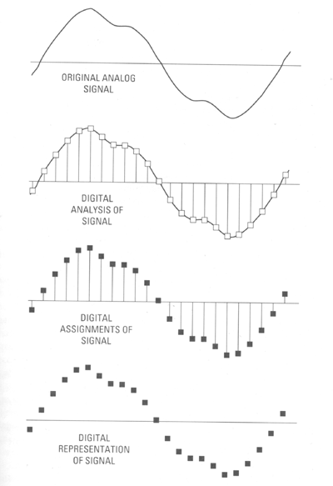
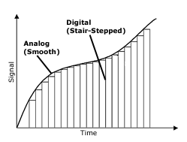
Extra
Example of sampling analog-to-digital (frequency at least 2 times higher than analog)
http://www.blazeaudio.com/howto/bg-digital.html
http://www.geardiary.com/2011/04/01/music-diary-notes-the-brave-new-world-of-digital-music/digital_sampling/

Slide 8
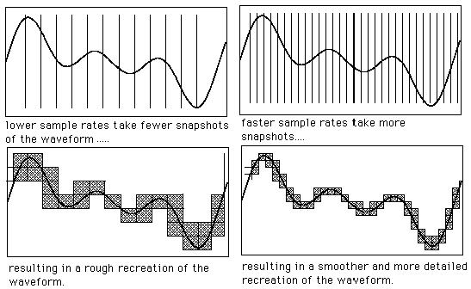
Extra
http://musicandcomputers306.blogspot.com/2010/10/waveforms-ad-conversion-sampling.html

Slide 9

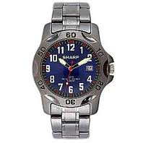
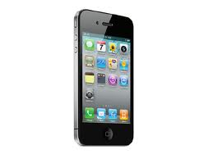
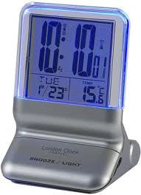


Extra
Self-Test:
Which of the following belong to analog system?
(a) (b) (c)
(d) (e) (f)
Resource: Google searched

Slide 10
Extra
Answer
(a) (c)
(e)
Resource: Google searched

Slide 11
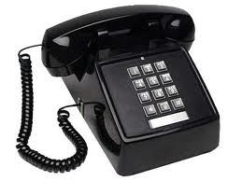
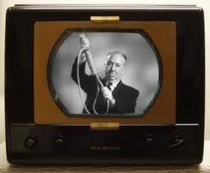

Extra
Example: Analog systems
Resource: Google searched

Slide 12
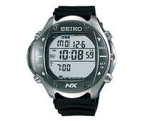

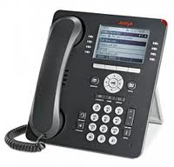
Extra
Example: Digital systems
Resource: Google searched

Slide 13
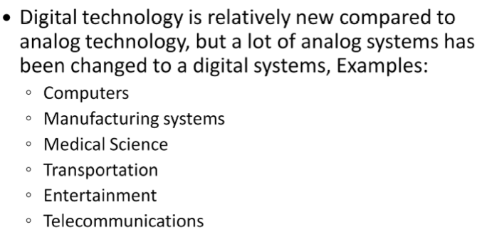
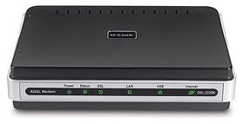
Digital
*DSL-2320B (ADSL Modem)
Resource: http://www.wirelessnetworkproducts.com/dsl-2320b.aspx

Slide 14
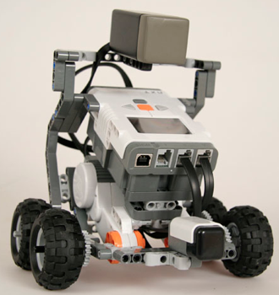
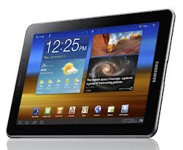
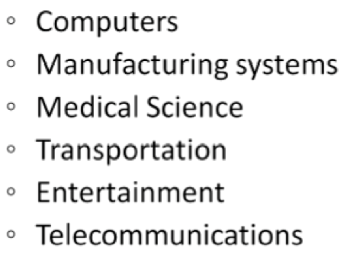
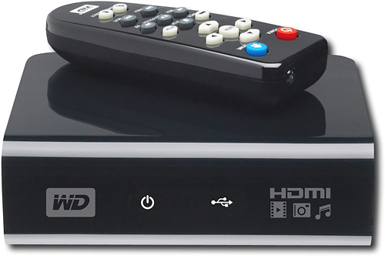
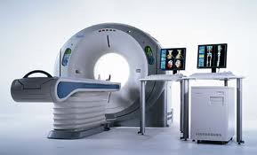
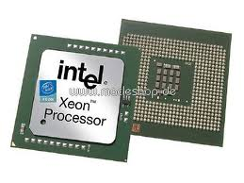
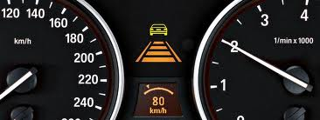
Digital
Exercise:
Match the picture to which digital application system it belong to.
(b)
(a)
(b)
(c)
(d)
(e)
(f)
(f)
(e)
(a)
(d)
(c)
Resource: http://www.wirelessnetworkproducts.com/dsl-2320b.aspx

Slide 15
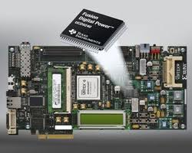

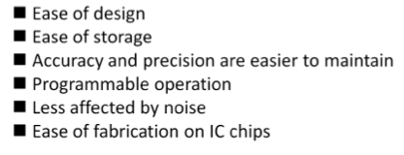
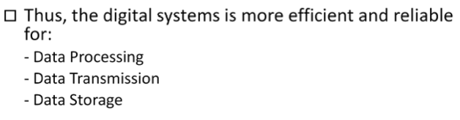

Slide 16

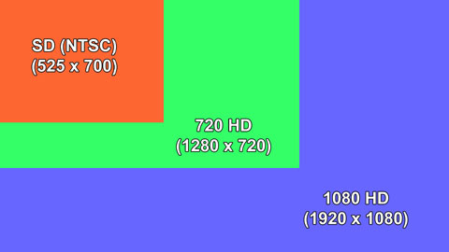

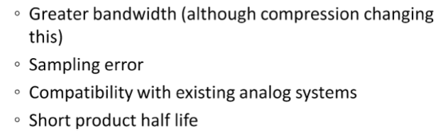
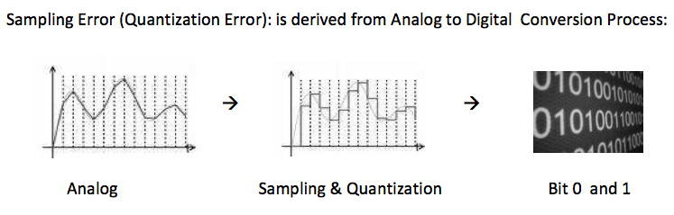
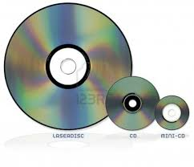

http://www.tvjuneau.com/images/HDTV-Resolutions_Full.jpg
20Mhz
6Mhz
Laserdisc, CD, minidisc

Slide 17

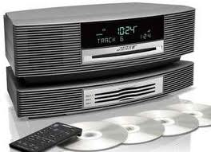
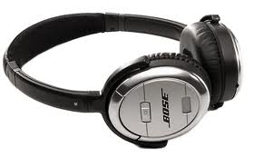
Analog and Digital Systems
Many systems use a mix of analog and digital electronics to take advantage of each technology.
A typical CD player accepts digital data from the CD drive and converts it to an analog signal for amplification.
http://www.it-echo.com/2009/11/14/bose-wave-music-system-and-multi-cd-changer-bundle.html
http://cdn-static.zdnet.com/i/story/61/18/006128/31929466-2-440-overview-1.gif
Resource: Floyd, Digital Fundamentals, 10th Edition

Slide 18
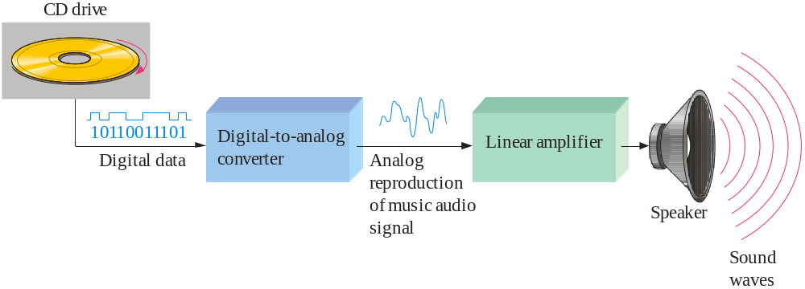


Resource: Floyd, Digital Fundamentals, 10th Edition

Slide 19
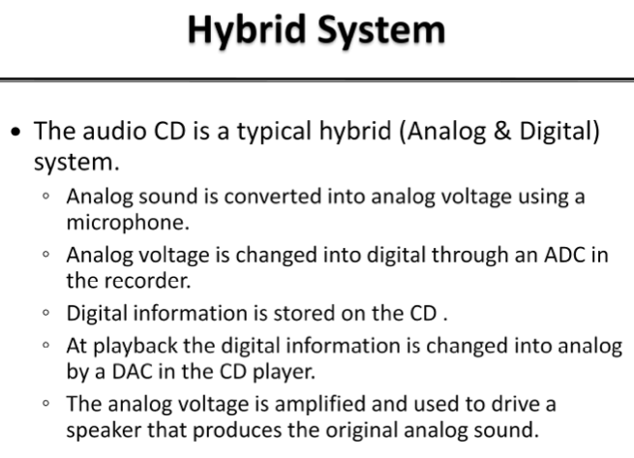

Slide 20
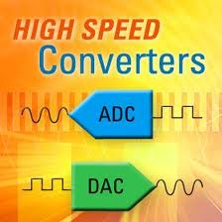


Conversion:
Analog to Digital Converter (ADC):
  Convert analog signal into digital signal using process such as sampling, quantization process and digital conversion.
  Error will occur during the sampling and quantization, hence loss of information can happen.
http://www.idt.com/products/data-converters
Digital to Analog Converter (DAC):
  Needed if the speaker is using analog system.
  Need to convert the digital data to analog signal in order for the speaker works properly and the sound can heard by human.
http://thesoundviewstudio.com/audio-rentals.html

Slide 21
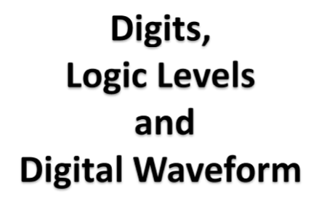

Slide 22
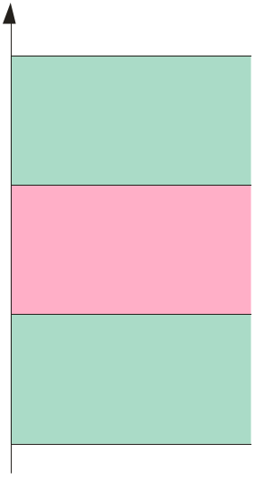

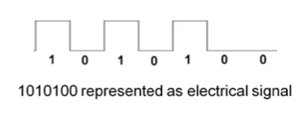
Binary digits and logic levels
Digital electronics uses circuits that have two states, which are represented by two different voltage levels:
V_{H(max)}
HIGH
V_{H(min)}
Invalid
V_{L(max)}
LOW
V_{L(min)}
A bit can have the value of either a 0 or a 1, depending on if the voltage is HIGH or LOW.
Resource: Floyd, Digital Fundamentals, 10th Edition

Slide 23
Digital waveforms change between the LOW and HIGH levels.
A positive going pulse is one that goes from a normally LOW logic level to a HIGH level and then back again.
Digital waveforms are made up of a series of pulses.
Resource: Floyd, Digital Fundamentals, 10th Edition

Slide 24
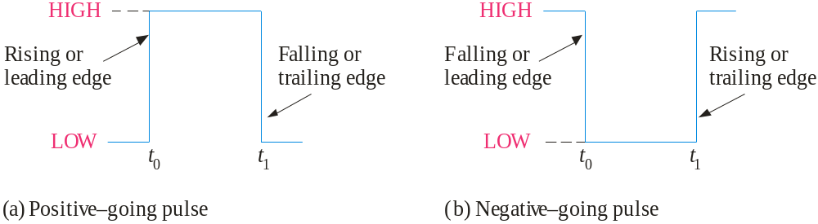
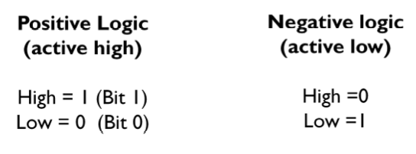

Slide 25
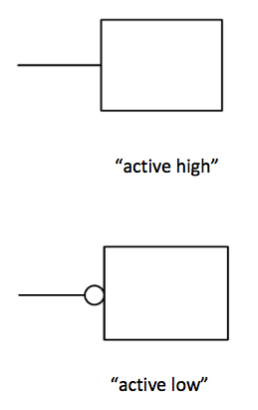

Slide 26
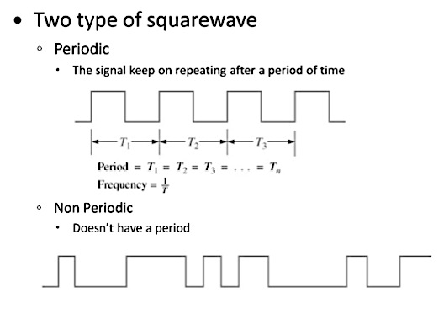
Digital Waveforms
Periodic
Non-Periodic / Aperiodic

Slide 27
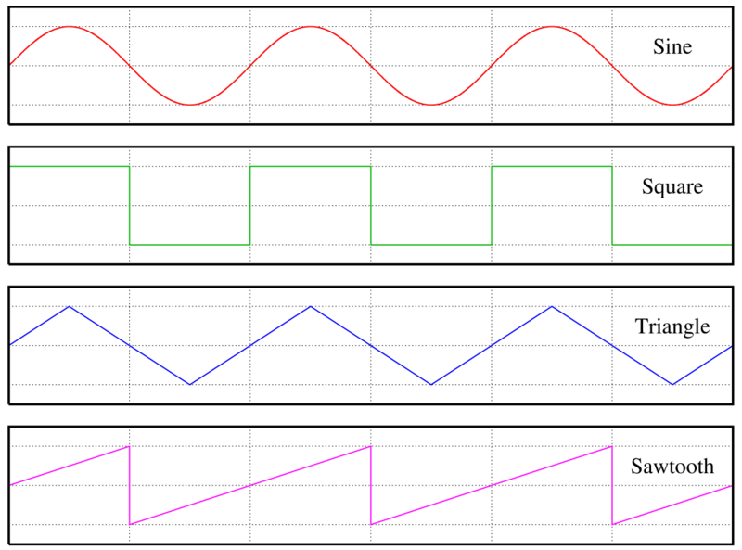
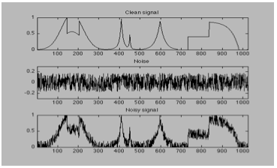
http://commons.wikimedia.org/wiki/File:Waveforms.png

Slide 28
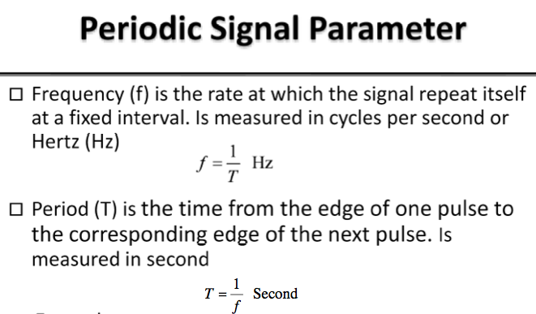
Hz
seconds

Slide 29
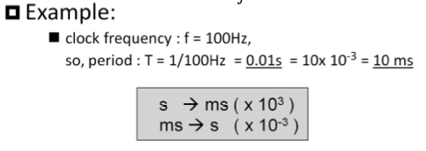



Slide 30


10³
10²
10¹
10⁻¹
10⁻²
10⁻³
http://ruthpawson.rbe.sk.ca/johnson_math0910

Slide 31


= (0.01 * 10⁻³) s x 10³
= (0.01 * 10⁻³⁺³) ms
= (0.01 * 10⁰) ms
= 0.01 ms
= (0.01 * 10⁻³) s x 10⁶
= (0.01 * 10⁻³⁺⁶) μs
= (0.01 * 10³) μs
= 10 μs

Slide 32




Exercise 1.1 :
Calculate the frequency of signals if time period are given as the following:
.
.
.
.

Slide 33




Exercise 1.2 :
Calculate the time period of signals if the frequencies are given as the following:
.
.
.
.

Slide 34


Pulse Definition
Resource: Floyd, Digital Fundamentals, 10th Edition

Slide 35

Repetitive Pulse Waveform
In addition to frequency and period, repetitive pulse waveforms are described by the amplitude (A), pulse width (t_{W}) and duty cycle.
Duty cycle is the ratio of t_{W} to T.
Pulse width (t_{W})
Amplitude (A)
Period, T
Resource: Floyd, Digital Fundamentals, 10th Edition

Slide 36


Slide 37



Exercise 1.3:
Given the duration or period of a system is 1000ms, determine the on state and off state of the system that operate with the ratio of duty cycle is 25%. Show your works.
On State
Off State
Solution 1.3:
Duty cycle → on state
Off state :
T = 1000 ms
(module: page 18)

Slide 38



Exercise 1.4:
Given the duration or period of a system is 1000ms, determine the on state and off state of the system that operate with the ratio of duty cycle is 50%. Show your works.
On State
Off State
Solution 1.4:
Duty cycle → on state
Off state :
T = 1000 ms
(module: page 18)

Slide 39



Exercise 1.5:
Given the duty cycles of a system is 40% for a duration of a system is 500ms.
Calculate the pulse width of the system.
Determine the off state of the system that operate with the ratio of duty cycle.
Show your works.
Solution 1.5:
a).
b).
(module: page 18)

Slide 40


Timing diagram
A timing diagram is used to show the relationship between two or more digital waveforms,
1 2 3 4 5 6 7 8
At time 8, all A, B, and C LOW
0 1 0 1 0 1 0 1 0
0 0 1 1 0 0 0 1 0
0 0 0 0 1 1 1 1 0
A diagram like this can be observed directly on a logic analyzer.
Resource: Floyd, Digital Fundamentals, 10th Edition

Slide 41

Bit time 3
Bit time 7
1 2 3 4 5 6 7 8
A = ?, B = ?, C = ?
A, B, and C HIGH
A = 1,
B = 1,
C = 1
A and B = HIGH = 1,
C = LOW = 0
Resource: Floyd, Digital Fundamentals, 10th Edition

Slide 42


0 1 0
0 0 1
1 0 1
0 1 1
0 0 0
Exercise:
Complete the truth table.
Resource: Floyd, Digital Fundamentals, 10th Edition

Slide 43





Data Transfer
Data can be transmitted by either serial transfer
Serial data
or parallel transfer.
Parallel data
Resource: Floyd, Digital Fundamentals, 10th Edition

Slide 44


Slide 45



Basic logic function
AND
True only if all input conditions are true.
OR
True only if one or more input conditions are true.
NOT
Indicates the opposite condition (inverter).
Resource: Floyd, Digital Fundamentals, 10th Edition

Slide 46



Slide 47



Slide 48



Slide 49



Logic Gates:
Summary
XNOR
Resource: http://www.chem.uoa.gr/applets/appletgates/Images/Image1.gif

Slide 50


Slide 51


Slide 52



Slide 53


Resource: Floyd, Digital Fundamentals, 10th Edition

Slide 54


Slide 55


Slide 56





Extra
http://www.chinese-symbols.com
http://www.ehow.com/how_7162480_convert-ascii-values-visual-basic.html
http://facebooksmileysinfo.com/wp-content/uploads/2012/04/Smiley-Facebook-emoticons.jpg
http://depositphotos.com/2746252/stock-illustration-Arabic-alphabet.html
http://allenmathblog.files.wordpress.com/2012/01/integers.jpg

Slide 57


http://msdn.microsoft.com/en-us/library/60ecse8t(v=vs.80).aspx
Extra
http://www.cool-smileys.com/wp-content/uploads/2009/06/regular-msn-emoticons.jpg

Slide 58



The encoding function
The decoding function
Resource: Floyd, Digital Fundamentals, 10th Edition

Slide 59


Resource: Floyd, Digital Fundamentals, 10th Edition

Slide 60


MUX
DEMUX

Slide 61






Flip-flop
Semiconductor Memories
Optical Memories

Slide 62



Examples:
Counter
Parallel output lines
Binary code for 1
Binary code for 2
Binary code for 3
Binary code for 4
Binary code for 5
1
2
3
4
5
Input pulses
Sequence of binary codes that represent the number of input pulses counted.
Resource: Floyd, Digital Fundamentals, 10th Edition

Slide 63


Slide 64

An example of laboratory prototyping is shown. The circuit is wired using DIP chips and tested.
DIP chips
In this case, testing can be done by a computer connected to the system.
(Dual In-line Package)
Resource: Floyd, Digital Fundamentals, 10th Edition

Slide 65


DIP chips and surface mount chips
Pin 1
Dual in-line package Small outline IC
(DIP) (SOIC)
Resource: Floyd, Digital Fundamentals, 10th Edition

Slide 66

Other surface mount technology (SMT) packages:
SOIC PLCC LCCC
(Small-outline IC)
(Plastic Leaded Chip Carrier)
(Leadless Ceramic Chip Carrier)
Resource: Floyd, Digital Fundamentals, 10th Edition

Slide 67




IC and conventional through-hole technology
Printed Circuit Board ( PCB)
Surface Mount PCB
http://aa7ee.wordpress.com/page/4/
https://neuromorphs.net/ws2007/wiki/smd
http://jeelabs.org/tag/teardown/
http://www.pcb-manufacturers.co.uk/pcb-production-examples-c.html

Slide 68


Integrated circuit
Cutaway view of DIP (Dual-In-line Pins) chip:
Resource: Floyd, Digital Fundamentals, 10th Edition

Slide 69



Slide 70



Extra
http://www.rkonlinestore.co.uk/556-dual-timer-ic-16-pin-dip-pack-of-4-391-p.asp
http://www.ebay.com/itm/10pcs-IC-TP5089N-DIP-16-PIN-TP5089-/310306081949
http://electroschematics.com/6529/7400-datasheet/

Slide 71



http://www.visual6502.org/images/263P/SSI_263P_8404_chip1_package_top.jpg
http://www.nysemagazine.com/lsicorp

Slide 72


(Transistor-transistor Logic)
(Emitter-Coupled Logic)
(Complementary Metal–Oxide–Semiconductor)
(N-Type Metal–Oxide–Semiconductor)
(Bipolar and Metal–Oxide–Semiconductor)
CMOS –
http://www.creativeplanetnetwork.com/dcp/news/cmos-technology-primer/40995

Slide 73


Slide 74


Slide 75


Slide 76


Resource: http://upload.wikimedia.org/wikipedia/commons/thumb/a/a3/
Altera_MAX_7128_2500_gate_CPLD.jpg/300px-Altera_MAX_7128_2500_gate_CPLD.jpg

Slide 77


Resource: http://upload.wikimedia.org/wikipedia/commons/thumb/f/fa/
Altera_StratixIVGX_FPGA.jpg/300px-Altera_StratixIVGX_FPGA.jpg

Slide 78

Resource: Floyd, Digital Fundamentals, 10th Edition
Notes:
MmaNaa @ 2011/12(1)

